Slide 1

Timelines of council decisions Reconstructing the decision-making processes of a city council based on references between documents
Thomas Schoegje
Lynda Hardman, Arjen de Vries, Toine Pieters
Notes:
Thomas, my research is focused around helping people find information. All of my work is applied towards improving the search engines of the municipality of Utrecht
Which is one of the largest municipalities in the Netherlands
From a search perspective, today’s talk is also about:
How do we help people see the bigger picture when they are looking for information

Slide 2
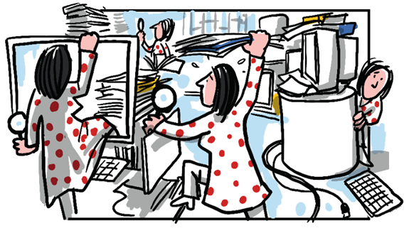
Notes:
In many organisations, finding the right information is an ordeal
Makes sense – when we create information, we usually don’t think about how we will archive or re-use it
So organisations end up with a pile of stuff, and people often don’t even know in which information source they should to search
So what can we do?

Slide 3
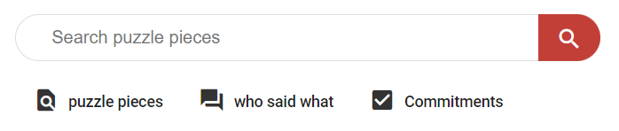
Notes:
Well, we can search
And if you build the search engine well, it gets pretty good at finding relevant fragments of information

Slide 4
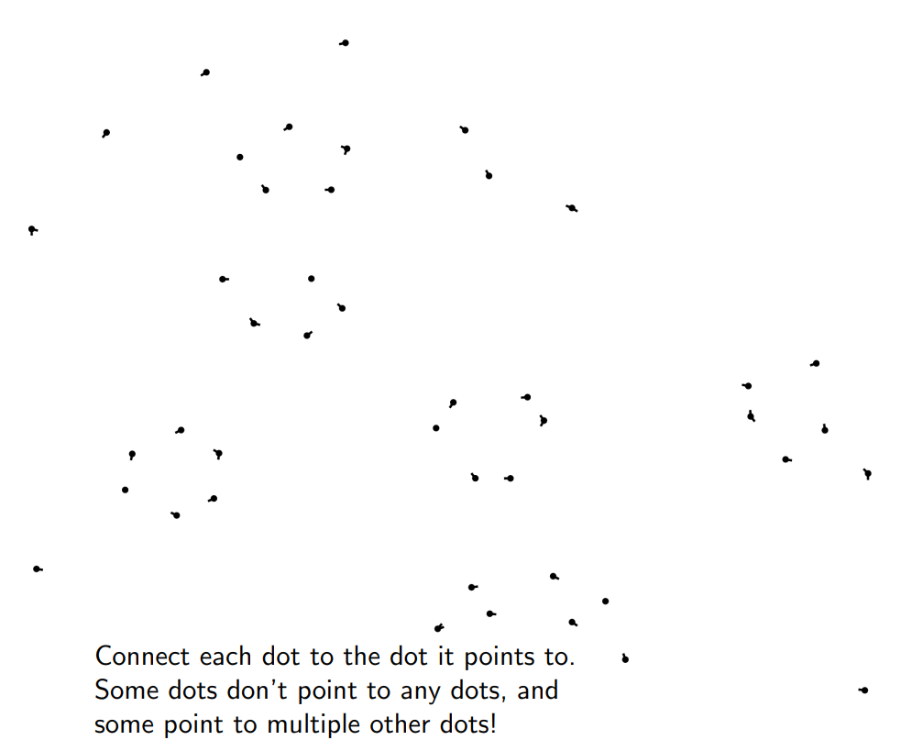
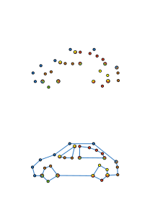

Notes:
Information fragments are great if you’re looking for a specific fact
But if you’re trying to explore something complex, it can be a bit more difficult to make sense of individual data points

Slide 5
Notes:
Information fragments are great if you’re looking for a specific fact
But if you’re trying to explore something complex, it can be a bit more difficult to make sense of individual data points

Slide 6
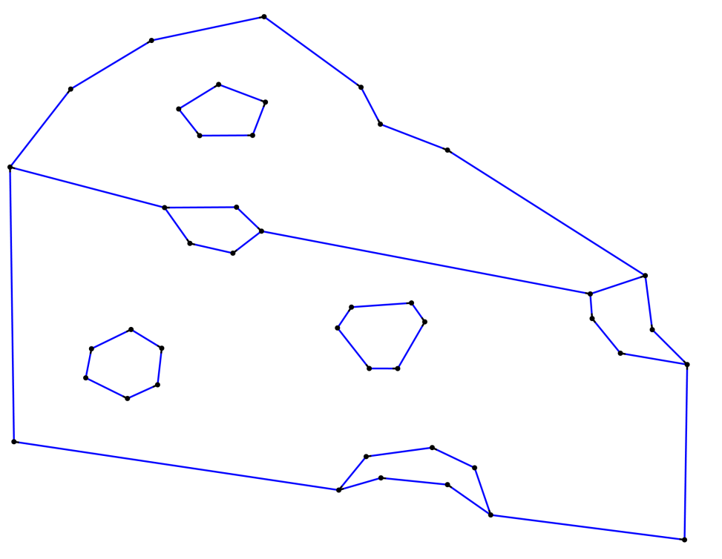
Notes:
Sometimes you need a bigger picture
So what does this mean for search? Depends on the domain and what the user is trying to do

Slide 7
Overview
Why timelines of council decisions
How experts create timelines
How to reconstruct timelines Approach 1: Document co-citation Approach 2: References between documents
Evaluation
Conclusion

Slide 8
Notes:
So lets look at what a council member would be trying to do
When they are searching for information, it is because they are trying to achieve some broader goal
For council members

Slide 9
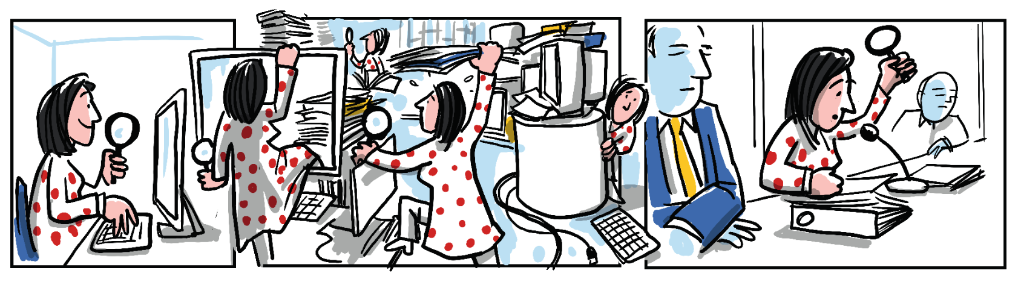
Notes:
This is usually because they are preparing for their weekly council meetings, where they want to make informed arguments and decisions
So what kind of information do they need to be informed?
There is usually some new information presented to them, but the challenge arises when the council has to figure out how they are going to EXTEND the policies of previous council members
And they need to understand how those decisions were made
So what does this decision-making process look like

Slide 10
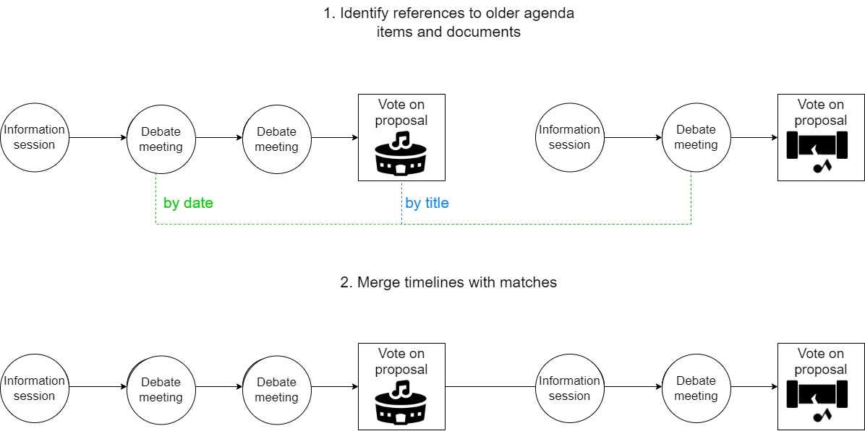

Notes:
The work of council members is oriented around weekly council meetings of different types.
Let’s take an example and say the council wants to create a new concert hall
That might start with an information session with external experts
Followed by commission meetings where they debate potential solutions
This will result in a policy proposal that the whole council will vote on

Slide 11
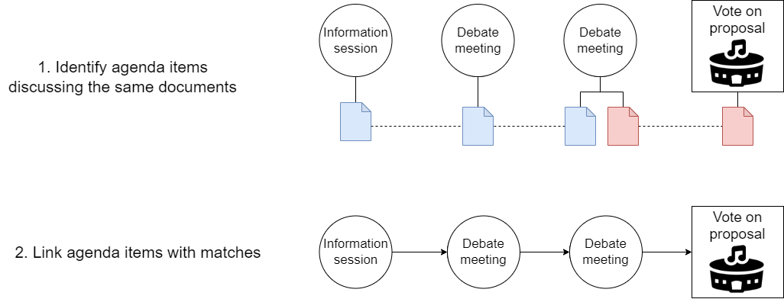
Notes:
Now let’s say that 2 years later this concert hall has been built, and it turns out there is a problem
There is a sound leak, so sound transfers between the different studios, making it impossible to hold two events at once
To understand the political context around the concert hall, it is important that council members understand how it was built
However, by now the city council consists of many new members. These new council members need some way to understand the political context
In the current situation,
What ends up happening is that some policy worker with expertise ends up manually creating a decision history

Slide 12
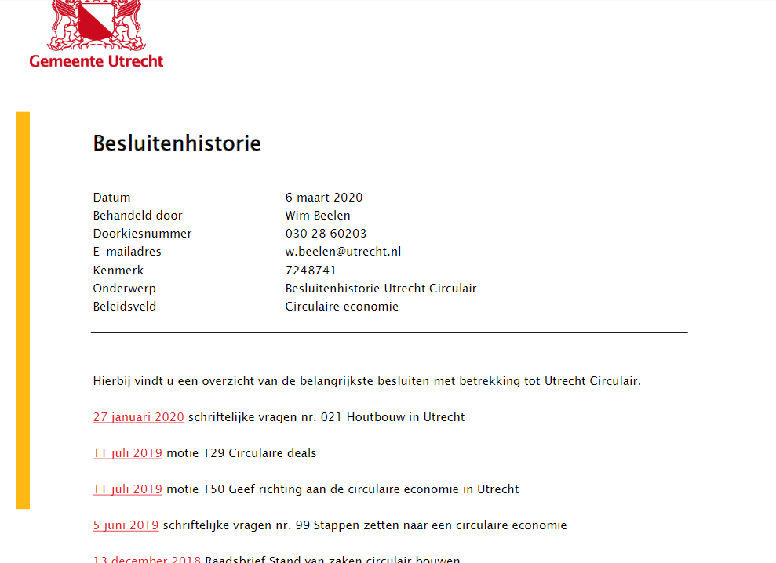
Notes:
Here’s what that looks like
We see that someone has listed a bunch of key decisions that the council has made in chronologiall order
That raises a question:

Slide 13
Research question
How can we create timelines of policy information?
Notes:
How could we automate that?

Slide 14
Research question
How can we create timelines of policy information?
Micro-level: What items should be included in the timeline?
Macro-level: How should the timeline be structured and presented?
Operationalisation: How can we algorithmically identify timeline items?
How should generated timelines supplement or replace manual timelines?
Notes:
Answering this question raises subquestions
Which individual items should be in there
How can we show the big picture is a useful way
How can we algorithmically achieve these things?
Can the timelines we create replace the manually constructed ones? Or is it more nuanced

Slide 15
How are manual timelines constructed?
Notes:
First, we explored how experts constructed these histories
We interviewed the authors of such interviews to consider what is important

Slide 16
How are manual timelines constructed?
Explorative interviews with authors:
There are no known guidelines
Start with known key documents, then search
Notes:
We found there was no established procedure, but that authors instead started with the key documents that they recalled, and then started searching

Slide 17
How are manual timelines constructed?
Explorative interviews with authors:
There are no known guidelines
Start with known key documents, then search
Best effort, not comprehensive (“No one checks”)
Subjective inclusion criteria (“Topics bleed over”)
Not scalable (“Cannot do it for every dossier”)
Notes:
As a result, the timelines are not perfect:
Best effort, not comprehensive
and there are subjective inclusion criteria – e.g. only council proposals, not all documents about the concert hall will be useful
we should not consider these as ground truth
It is of course not very scalable – it only happens when the need outweighs the cost of making it

Slide 18
Overview
Why timelines of council decisions
How experts create timelines
How to reconstruct timelines Approach 1: Document co-citation Approach 2: References between documents
Evaluation
Conclusion
Notes:
So what can we do
We’re going to combine two approaches
These approaches work because the decision-making process itself is fairly structured. This structure is reflected in how to documents are written and used.

Slide 19
Approach 1: document co-citation
Notes:
Let’s first look at the co-citation approach:
The first approach exploits the fact that the council has staff who prepare meetings by attaching the documents that will be discussed. As a consequence, different meetings that discuss the same blue document will be about a directly related topic.

Slide 20
Approach 1: document co-citation
Notes:
The first approach is to identify when the same document is re-used during different meetings, and then group agenda items about the same document
An important nuance here is that the blue document might be refined over time, and modified slightly. That is why we try to identify different versions of the same document, by identifying near-duplicate documents.
We detected near duplicate documents by looking for documents with the same title and a similar filesize.

Slide 21
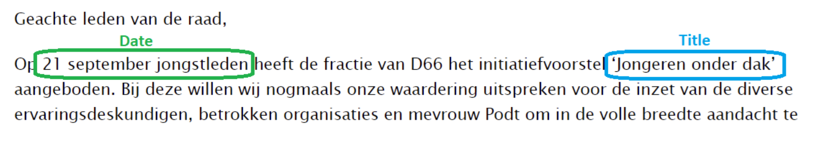
Approach 2: in-text references
Notes:
Our second approach is based on how council documents are written.
Council documents are written according to guidelines, and therefore always state the reason for writing the city council. This reason usually refers to a previous council decision or council document
Here is an example of a document that refers to a previous document by the document date and references its by the document title

Slide 22
Approach 2: in-text references
Notes:
Our second approach extracts such references from the text of documents, identifies the target of the references and then makes a link between both agenda items.

Slide 23
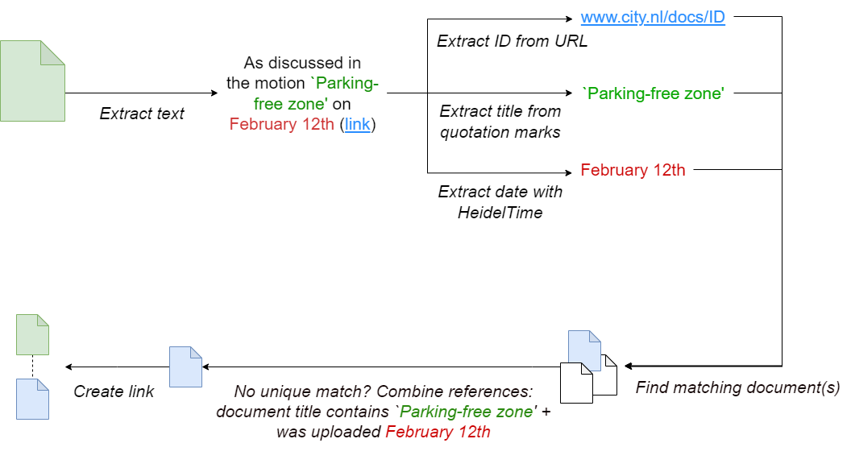
Approach 2: in-text references
Notes:
The pipeline for this approach looks like this
We extract three types of references: hyperlinks, titles and dates. For each reference, we then try to find documents or council meetings that fit the reference
In the case of URLs there is always a unique match, but sometimes document titles are similar. In those cases, we try to disambiguate the reference by combining different references in the same sentence
If we find a unique target, the target and source document should be in the same timeline

Slide 24
Combining approaches
Document co-citation
+ timelines individual policy proposals
+ models weekly decision-making
In-text references
+ timelines between policy proposals
+ timelines at larger time scale
Combining approaches
2500 timelines (~15.000 agenda items, ~29.000 documents)
Notes:
Both approaches have different strengths.
The first approach is strong at creating timelines for individual policy proposals – models the weekly decision-making
The second approach is strong at creating timelines between multiple policy proposals – models the decision-making at larger time scale
By combining both approaches we could merge the 15.000 agenda item down into 2500 timelines

Slide 25
Overview
Why timelines of council decisions
How experts create timelines
How to reconstruct timelines Approach 1: Document co-citation Approach 2: References between documents
Evaluation
Conclusion
Notes:
So we have a way to construct timelines, and it’s time to see if those timelines make any sense

Slide 26
Evaluation
Two challenges:
Micro level: No ground truth showing which documents are relevant (manual timelines are incomplete and subjective)
Macro level: Unclear how to present a timeline of policy information (how to deal with decisions, documents, agenda items)
Hence we design an evaluation to address both of these points
Notes:
The evaluation is not super straightforward, as there are two challenges
When we want to measure if the individual documents are useful, we would need a ground truth showing which documents are relevant
We can use the manual timelines for some things, but they are incomplete and subjective
When we want to measure if a timeline as a whole is useful we first run into a sub-problem: how do we even present it in the interface
To address both of these challenges, we opted for a qualitative evaluation

Slide 27
Evaluation
Exploratory study with dual purpose:
Micro level: Evaluate relevance of documents in timeline (quantitative) and reasons for relevance (qualitative)
Macro level: Investigate how to design an interface to display timelines of policy information (qualitative)

Slide 28
Evaluation
Population: Ten policy workers (six female, four male)
Task: Understand how the council came to a policy proposal while thinking aloud. Use a generated/manual/combined timeline

Slide 29
Evaluation
Task procedure:
Read policy proposal
Chronologically timeline documents Per document: clarify what happened
Per document: assess document relevance, provide reasoning
Consider completeness of timeline
Interactive session with space to discuss themes and questions

Slide 30
Results
When is a document relevant (RQ1):
Documents are relevant to a policy proposal if both track their provenance back to a previous council decision
Notes:
When we look at the document level, we found that documents are relevant to a council proposal
If they are both done as a consequence of the same council decision, so if can both track their provenance to the same decision

Slide 31
Results
When is a timeline useful (RQ2):
Balance conciseness and completeness: > Display compact view with only council decisions (decision-layer) > Extend results to display all intermediate steps (provenance-layer)
Notes:
The timeline as a whole needs to be both concise at times and complete at other times. This suggests we should create an interface that is concise at first, and can be extended to show the exact stepstaken

Slide 32
Results
Can our method identify relevant documents (RQ3):
97% of generated timeline documents were relevant
Document co-citation and in-text references are reliable signals Main limitation: Can only identify target of 39% of textual references Further 52% of references finds a subset of possible targets
Notes:
We found that our approach nearly only includes relevant documents
This implies that both of our approaches are based on very reliable signals
The main limitation is that we cannot disambiguate many in-text references to a single target document
We’re ignoring those references at the moment.

Slide 33
Results
Comparing manual and generated timelines:
Both generated (97%) and manual (97%) included mostly relevant items
However, limited overlap between generated and manual timelines Documents contain less references if decision history exists? Good at different things?
No qualitative differences emerged in this study
Notes:
When we compared the two timelines we found that they both mostly have relevant documents
However, there is little overlap in the sets of documents of both
It is unclear why this is the case. When a decision history exists, it is likely that the authors of documents refer to the decision history instead of the individual documents No qualitative differences emerged in our study. A comparative study could investigate this in more detail

Slide 34
Results
Generated timelines are not perfect, and manual timelines may offer a complementary perspective. For now, they should be combined (RQ4):
Generated timelines are a scalable way to generate initial histories
For complex dossiers, experts can check and extend timelines

Slide 35
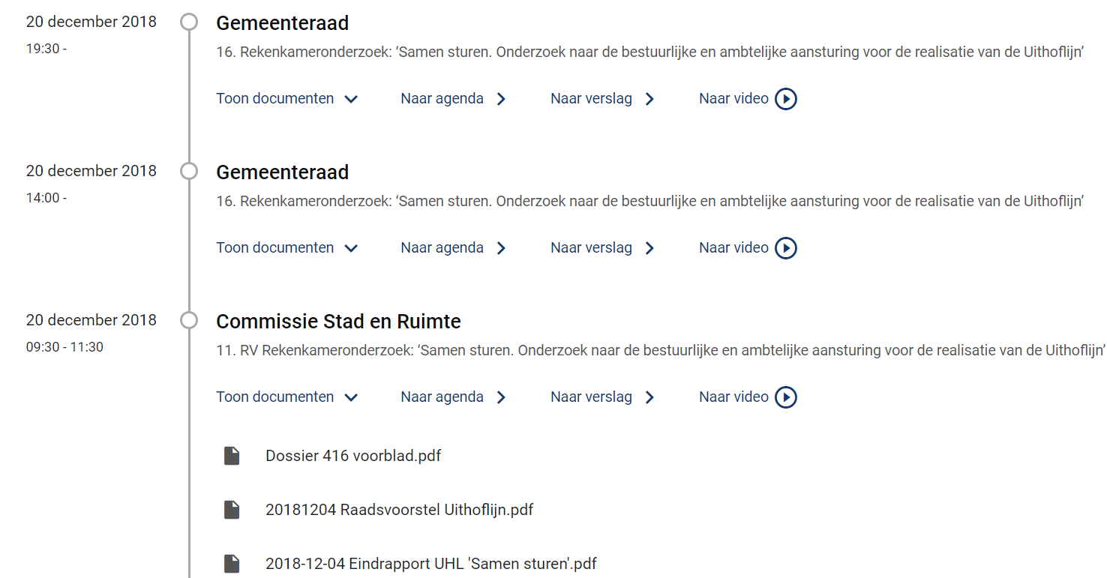
Results
Notes:
Based on our approach, we included timelines of council information in the search engine
Users can search as usual, but when they click a search result they get this overview perspective
This interface should be updated to reflect all of our findings, and in the future it should be evaluated
But for now, council members are using this to help find useful information

Slide 36

Conclusion
We can algorithmically make governmental information more transparent and interpretable
For complex dossiers, we should keep experts in the loop
Contact: t.schoegje@utrecht.nl

